Slide 1

Presentation ON :
How To create a web server in Raspberry pi & Host A Website on It.

Slide 2
Presented to: MD Ataullah Bhuiyan Lecturer Department of CSE City University
Presented by: Md Pias Hossain - 163432563
Md Rasel Hossain- 163432521
Mehedi Hasan - 163432564
Alamgir Hossain - 163432584

Slide 3
WELCOME TO OUR PRESENTATION

Slide 4
INTRODUCTION
The Cloud has become a greatly overloaded term over the last few years. It covers many services and technologies. Large cloud vendors offer data center host web applications.
The cloud concept shown in the picture below, is defined by NIST (National Institute of Standards and Technology).

Slide 5
BACKGROUND HISTORY
A trend towards cloud computing is going on for several years now. Along with this trend, several issues and concerns regarding privacy and security emerged. This report starts off by briefly explaining the current challenges of traditional computing,
Mainly, the practice of ‘cloud computing’ defined and explained, together with a variety of user options. One particular option is private cloud using a Raspberry Pi. The reader is guided with a step-by-step setting up the necessary configurations. This setup is popular commercial cloud services

Slide 6
REQUIREMENTS:
A RaspBerry Pi Device.
A Class 10 SD Card for smooth & faster system.
Router & Cable.

Slide 7
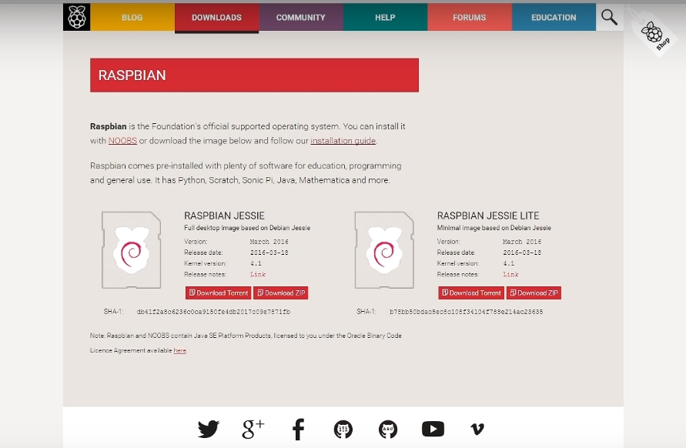
INSTALLATION:
Install a Raspberry Jessi Lite from Raspberry Pi official website. Its too easy & need just 5 minutes.

Slide 8
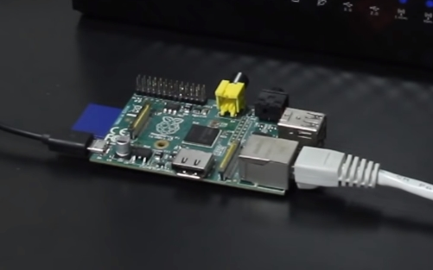
CONNECTIONS:
After install the OS on SD Card , Insert the SD card on RaspBerry Pi & plug the Ethernet cable & power cable on it.

Slide 9
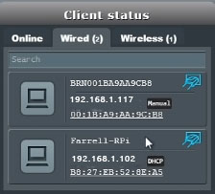
FIND THE IP ADDRESS:
We need to find the IP address to install SSH – Web server on our Raspberry Pi. After connected RP (Raspberry Pi) , we can found the IP of RP on the router clients section. My RP’s IP is : 192.168.1.102

Slide 10
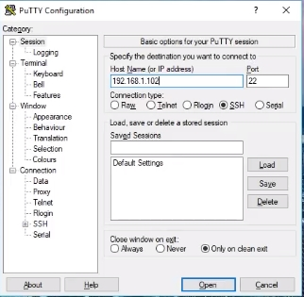
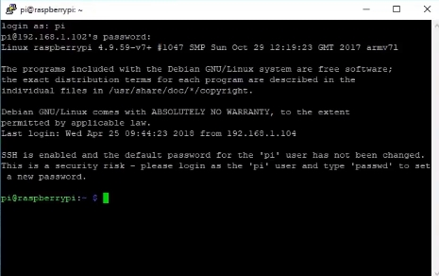
Install Web Panel on R.Pi By SSH:
We use Putty Software to install server on RPi. Open Putty and input the ip address of RP. Now open & this will open a Command Page. There ask your login details. Raspberry Pi’s default login is “Pi” & Password “Raspberry”.

Slide 11
Need Commands To Install Apache Server & PHP:
Apache : sudo apt-get install apache2
PHP : sudo get-apt install libapache-mod-php
Reboot : sudo reboot

Slide 12
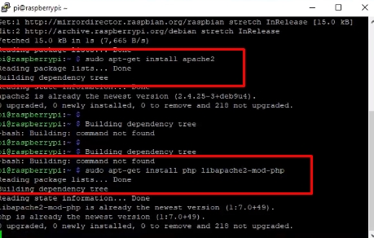
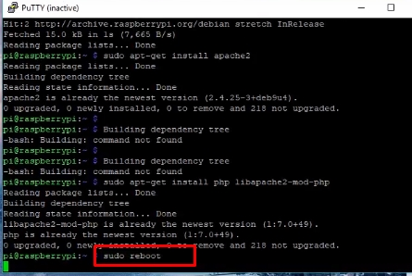

Slide 13
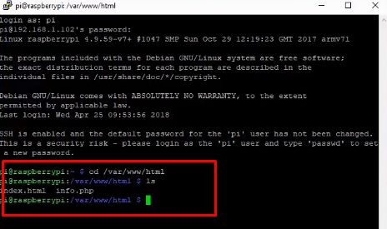
INSTALLATION GUIDE:
By these commands , we can install our server on Raspberry Pi. Our directory is : /var/www/html.Now we will enter on our web directory. For this , go to Putty & input our IP & details. Now hit this command : cd /var/www/html . Here you can extract any website software like “Wordpress” etc.

Slide 14
For Example:
You want to extract Wordpress in directory /vr/www/html , we need to hit this commands :
cd /vr/www/html
We get https://wordpress.org/latest.tar.gz
tar xfz latest.tar.gz
These commands will download wordpress core files in your directory & extract it. You will get the wordpress installation page very easily.

Slide 15
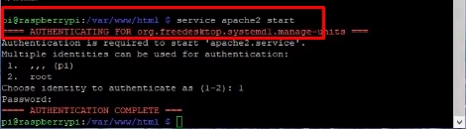
Now we have to start apache server:
For this , we will hit this command.

Slide 16
Create a index.html file in Our IP (server):
Follow these commands
Create a file : vim index.html
Edit this file : vi index.html
Suppose I will write these html codes :
<html>This is our website.</html>
To save , I will enter this : :wq

Slide 17
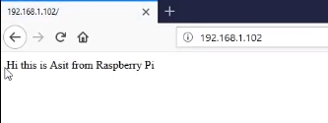
Now we’ll check our server via IP Address:
Go to your browser & type your ip. My ip : 192.168.1.102 . & its working.
This is Our Site !!

Slide 18
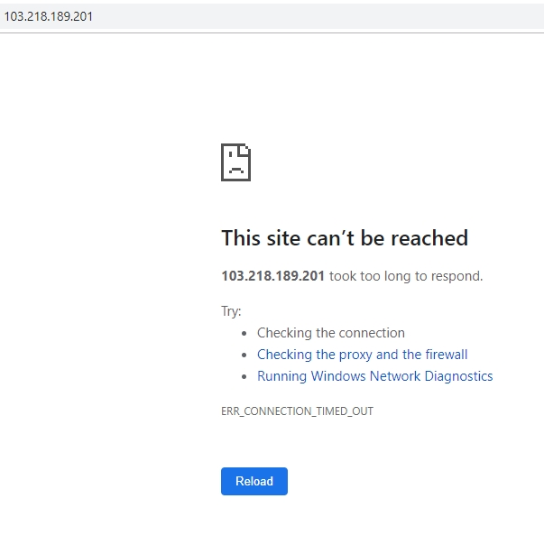
PROBLEM:
Its Called PORT FORWARDING.
There has a problem. It’s a local server. But we want to use it worldwide on internet. Now we need to forward our port in our router. Other it will not be opened.

Slide 19
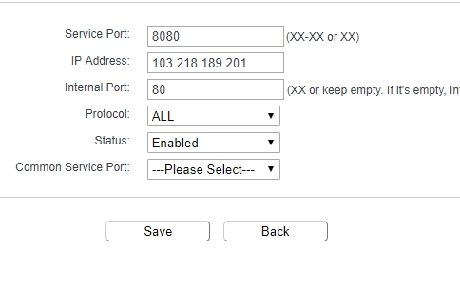
Port Forwarding:
Go to your router > Forwarding > Virtual > Add New . Now Set It following this screenshot & save it. In IP address , you have to put your own public IP .You can find it on router home page in “WAN” section.

Slide 20
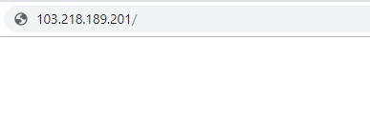
Try Working Or Not:
Now again we enter our IP address : 103.218.189.201 (Public IP)
Yah! Its working now.
This is Our Site !!

Slide 21
CONCLUSION
That’s a way , how you can create a Basic web server via Raspberry Pi in your home. Its too easy and cheap than buy a host server every month. Its not so powerful , but you can create manage your personal web server in your home & use it for personal purpose.

Slide 22


